Slide 1
The Deep Dive Chair Design
By
Kadeem Whyte

Slide 2
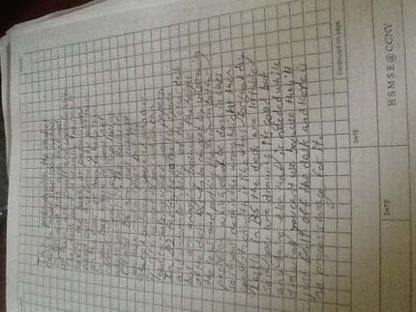
Define the problem
We started out with just writing out a paragraph that went one by one and described the problems of desks in each room of the HSMSE building and if there were advantages we would write those also

Slide 3
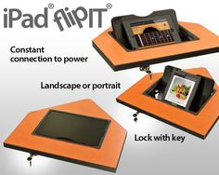
Research and Generate Ideas
We went online and searched for different desks that can help us make our final design and wrote the pros about each table so we could refer to it later.
This is one way modern technology can be put into the design but the desk will be bigger to fit more than just the ipad or laptop and will also include an outlet for the tech to charge at all times as sometime kids forget to plug them in.

Slide 4
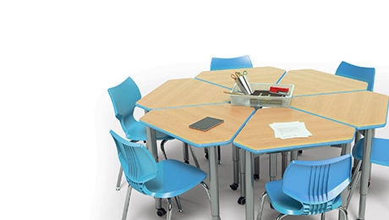
Research and Generate Ideas
This design has easily adjustable tables and the material is easy to clean also. These desks also have a colorful design that would look nice in a classroom environment and can also make groups or come apart easily.

Slide 5
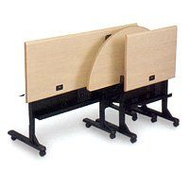
Research and Generate Ideas
Use of the way these tables fold would allow for the easy storage of the desks during breaks in order for janitors clean rooms better without going through or making teachers go through the pain of moving desk out of the way that are fairly big and hard to move.

Slide 6
Identify Criteria and Constraints

Slide 7
Explore Possibilities
After researching we got many ideas and decided to add,
Baskets that are detachable to the sides of the desk
The top of the desk can fold onto the legs and stack with other tables well
There is a cylinder shape groove in the desk to allow pens and pencils to be placed in
Desks are larger than normal one person desk but smaller than two person desks
The legs of the desk are retractable so they can easily be adjusted for students of different height
A built in space for a tablet or laptop that has a lockable front casing on it
Table is a trapezoid shape in order to allow for easy group creation and also arm rest for both left and right handed students

Slide 8
Select an Approach
Our design is a fairly big but storable design that will allow the betterment of student classroom life with more space to work and store any materials they may need to at the side. Also there is a pencil holder in the desk and a durable tablet/laptop compartment at the top that can be charged right from the desk thorough outlets on the side. The desk is in a trapezoidal shape in order for better arm placement options for students and also allows for the easy storage of detaching the baskets on the side, folding up and then being stacked on to each other neatly. Lastly the legs of the desk retract or elongate to adjust the tables height for smaller or bigger students.

Slide 9
Develop a Design Proposal

Slide 10
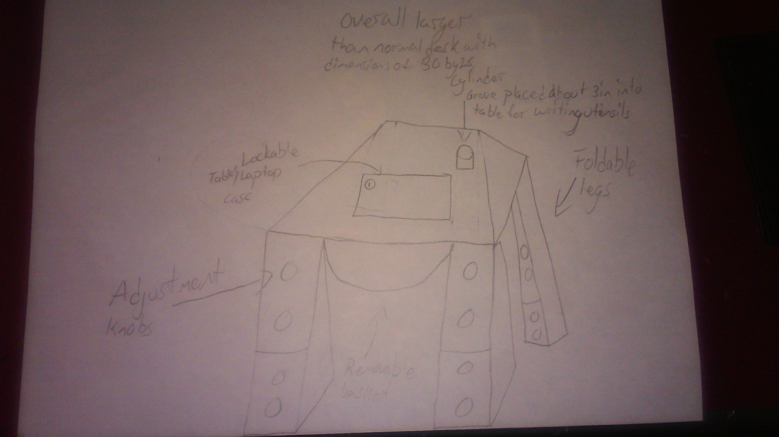
Model A Prototype

Slide 11
Model A Prototype

